Slide 1
Data Link Layer Protocols
Prof. Ramesh Ragala

Slide 2
Data link layer protocols
Assumptions
process of physical, datalink and network layers are independent.
physical and data link layer process running in network I/O chip and network layer in main CPU.
machine A want to transmits long stream of data to machine B using reliable and connection oriented service.
A is assumed to have infinite supply of data ready to send and never wait for data to be produced.
machines don’t crashes. → errors with protocols only.

Slide 3
Protocol 1: An Unrestricted Simplex Protocol
Data Transmission in one direction and processing time is ignored.
The receiver is always ready to receive the next frame (has infinite buffer storage).
Error-free communication channel. → unrealistic → utopia protocol
No acknowledgments or retransmissions used.
If frame has d data bits and h overhead bits, channel bandwidth b bits/second:
maximum channel utilization = data size/frame size = d/(d + h)
maximum data throughput = d/ (d + h ) * channel bandwidth = d/ (d + h ) * b
Frame transmission time =
(d+h)/b
b = channel bandwidth
One way
Channel delay
or latency l
Data Frame 1
Data Frame 2
Data Frame 3
Data Frame 4
Data Frame 5
Sender
:
:
:
:
:
:
Receiver
Data Frame 6
:
:
:
:
:
:

Slide 4
Protocol - 2
Assumptions :
drops the ability to receive large amount of data @ receiver side → both at data link layer and network layer.
communication channel is error free.
data traffic is simplex.
problem : how to prevent the sender from flooding the receiver with data faster than the latter is able to process them.
Solution – 1: just put the delay at sender side of protocol – 1 → more time delay → inefficient. b/w utilization far from optimization. → not good idea.
Solution – 2: feedback from receiver to sender about data transmission.
so sender sends one frame and then waits for an acknowledgment before processing is called STOP – AND – WAIT protocol.

Slide 5
Protocol #2: A Simplex Stop-and-Wait Protocol
The receiver may not be always ready to receive the next frame (finite buffer storage). Feedback .
Receiver sends a positive acknowledgment frame to sender to transmit the next data frame.
Half duplex channel is used.
Maximum channel utilization ≈ (time to transmit frame /round trip time) * d/(d + h)
≈ d/ (b * R)
Maximum data throughput ≈ channel utilization * channel bandwidth
≈ d/ (b * R) * b = d/ R
Time
Round trip
time, R
Data Frame 1
Acknowledgment Frame
Data Frame 2
Sender
Receiver
Acknowledgment Frame
:
:
:
:
:
:

Slide 6
Protocol-3 → noisy channel
normal communication channel → errors.
frames either damaged or lost completely
checksum used to detect the errors in frames. If it is unable to find the error, then this protocol fails.
variation of protocol – 2:
adding timer → for acknowledgment.
sender waits after transmits frame → receiver sends ack if frame is ok, otherwise it will not send any ack.
so timer expires @ sender and retransmits frame.
problem → ack is lost → duplicate of frames @ receiver.

Slide 7
Protocol-3 → noisy channel
So receiver need to find the duplicate frames.
So sender puts the sequence number in the header of each frame. → duplicating problem solved
New problem is what is the size of sequence number and how many bits are used to represent the sequence number?
1- bit sequence is enough. The receiver expecting particular sequence number next. So sender and receiver maintaining sequence numbers.
Once the receiver receives correct sequenced frame, it process and sends to network layer. Then it is expected sequence number is incremented by modulo 2.

Slide 8
Protocol 3: A Simplex Positive Acknowledgment with Retransmission (PAR) Protocol or ARQ
Receiver sends a positive acknowledgment frame to sender to transmit the next data frame. Any frame has a sequence number, either 0 or 1
Maximum utilization and throughput similar to protocol 2 when the effect of errors is ignored.
Round trip
time, R
Data Frame 1, sequence # 0
Time
Ack Frame, sequence # 0
Data Frame 1, sequence # 1
Receiver
Sender
Ack Frame, sequence # 1
:
:
:
:
:
:
Data Frame 1, sequence # 0

Slide 9
Example
A channel has a bit rate of 4 kbps and propagation delay 20 msec. for what range of frame sizes does stop and wait protocol give an efficiency of at least 50%?
Sol
data rate → 4*10³
Propagation delay → 20*10⁻³
i.e. RTT → 40 * 10⁻³
efficiency is at least 50%
length of frame = RTT * Bit Rate
→ 160 bits per frame.

Slide 10
Sliding window protocols
data transmission in both the directions
Case – 1: use full duplex data transmission with two separate communication channel and each with simplex data transmission. → bandwidth wasted
Case – 2: use same circuit for both data transmissions.
piggybacking : data + ack (Problem– waiting time)
so called sliding protocols.
each out bounded frame contains sequence no, range from 0 to maximum. (2^{n}-1) → n bits for sequence no.
sending window and receiving window. (What are the reasons). It also maintains buffer to store frames.

Slide 11
Sliding window protocols
the lower and upper bound and size may not be same for both sending and receiving window.
the sequence number with in the sending window indicates the frames which have been sent or waiting for ack.
When new frame came, it assigns a sequence no, which is incremented by one. → upper boundary advanced by one.
when ack comes from receiver side, then the sending window lower boundary advanced by one.
So sending window maintains the unacknowledged frames.
At receiver side, the frame is accepted and sends back ack, iff the received frame sequence no must equals the lower boundary of window.

Slide 12
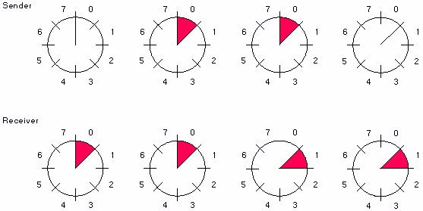
A Sliding Window Protocol of Size 1 with a 3-bit Sequence Number
(b)
After the
first frame
has been
sent
(c)
After the
first frame
has been
received
(d)
After the first
acknowledgment
frame has been
received
(a)
Initial
state

Slide 13
One bit sliding window protocol
maximum window size as 1 only.
uses stop and wait protocol
problems:
normal case any one of the station sends the data
what happened both the stations starts transmits the frames at same time.
even there is no transmission errors, half of the frames are duplicates.

Slide 14
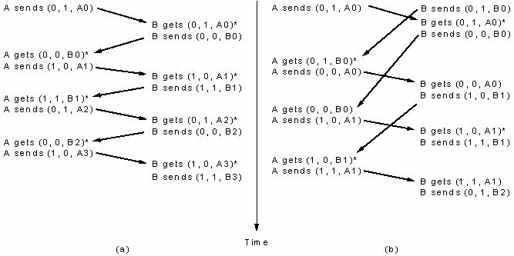
Two Operation Sequences For Sliding Window Protocol (#4)
(a) Normal Protocol Operation:
No duplicate packets
(b) A special situation:
Half the frames contain duplicates
* Network layer accepts a packet.

Slide 15
Channel Utilization & Data Throughput For Sliding Window Protocols
b = Channel bandwidth or transmission rate bits/sec
FS = Frame size = # of data bits + # overhead bits = d + h
R = Channel round trip time
N = Send/receive window size
p = Probability frame a data frame is lost or damaged
Ignoring errors, condition to maximize Utilization/Throughput:
Time to transmit N frames ≥ Round trip time
FS/b * N = (d + h)/b * N ≥ R
Under this condition:
Maximum channel utilization ≈ data size/frame size = d/(d + h)
Maximum data throughput ≈ d/FS = d/(d + h ) * b
Including the effect of errors only on data frame; assuming selective repeat:
On the average p data frames have to be retransmitted
Under these condition: Total Data Frame overhead = h + p * FS
Maximum channel utilization ≈ d/[(1 + p)*FS]
Maximum data throughput ≈ d/[(1 + p)*FS] * b

Slide 16
Performance of Stop-and-Wait Protocol
In previous protocols , we assumed that no transmission delay for data and also for ack.
but it is not the case for real applications.
Example → 50kbs satellite channel with 500msec RTT
imagine it uses protocol – 4 for sending for 1000 bits frame
@ 20 msec the frame is completely sent. → total time 270msec. → total 520 for one full transmission
→ 500/520 → 96% → 4% was used.
combination of long transit time, high bandwidth and short frames → decreases the efficiency.
Long transit time + high bandwidth + short frame length ⇒ disaster

Slide 17
Performance of Stop-and-Wait Protocol
Assumption of previous protocols:
Transmission time is negligible
False, when transmission time is long
Example - satellite communication
channel capacity: 50 kbps, frame size: 1kb
round-trip propagation delay: 500 msec
Time:t=0 start to send 1st bit in frame
t=20 msec frame sent completely
t=270 msec frame arrives
t=520 msec best case of ack. received
Sender blocked 500/520 = 96% of time
Bandwidth utilization 20/520 = 4%
t
0
20
270
520

Slide 18
Go Back n Protocol
Receiver discards all subsequent frames following an error one, and send no acknowledgement for those discarded
Receiving window size = 1 (i.e., frames must be accepted in the order they were sent)
Sending window might get full
If so, re-transmitting unacknowledged frames
Wasting a lot of bandwidth if error rate is high

Slide 19
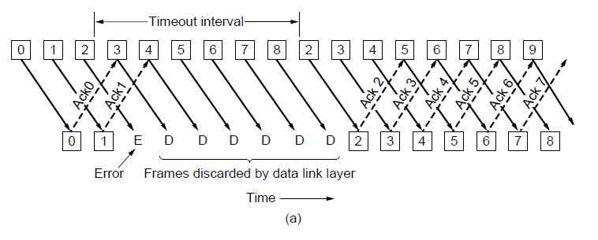




Go Back n Protocol

Slide 20
Go Back n Protocol
S
R
0 1 2 3 0 1 2 3 0
Time
Frame 0
0 1 2 3 0 1 2 3 0
0 1 2 3 0 1 2 3 0
0 1 2 3 0 1 2 3 0
Frame 1
0 1 2 3 0 1 2 3 0
ACK 1
0 1 2 3 0 1 2 3 0
Frame 2
0 1 2 3 0 1 2 3 0
ACK 2
0 1 2 3 0 1 2 3 0
0 1 2 3 0 1 2 3 0
Frame 3
0 1 2 3 0 1 2 3 0

Slide 21
Go Back N
Go-Back-4:
4 frames are outstanding; so go back 4
fr
0
fr
1
fr
2
fr
3
fr
4
fr
5
fr
6
fr
3
fr
4
fr
5
fr
6
fr
7
fr
8
fr
9
time
A
B
ACK1
ACK2
ACK3
Out-of-sequence frames
ACK4
ACK5
ACK6
ACK7
ACK8
ACK9
error
ACKing next frame expected

Slide 22
Go Back N
with NAK error recovery
Transmitter goes back to frame 1
Go-Back-7:
fr
0
fr
1
fr
2
fr
3
fr
4
fr
5
fr
1
fr
2
fr
3
fr
4
fr
5
fr
6
fr
7
fr
0
time
A
B
ACK1
NAK1
Out-of-sequence
frames
ACK2
ACK3
ACK4
ACK5
ACK6
ACK7
error
Copyright ©2000 The McGraw Hill Companies
Leon-Garcia & Widjaja: Communication Networks
Figure 5.17

